Slide 1
Automated Text Summarization
Jamaal Hay

Slide 2
Overview
Goal: Reducing text with a computer program in order to create a summary that retains the most important details of the original text.
Applications
Action Items from a meeting
Simplifying text by compressing sentences
Important notes in E-mails

Slide 3
Extractive vs Abstractive
Extractive – This approach operates by selecting sentences from the corpus that best represent it and then arranging them to form a summary.
Abstractive – This approach operates by using natural language techniques to summarize a text using novel sentences.

Slide 4
Evaluation
The main evaluation metric used is called ROGUE, which stands for Recall-Oriented Understudy for Gisting Evaluation. There are multiple variations of ROGUE, such as ROGUE-1, ROGUE-2, ROGUE-L etc. with different mathematical formulations. But the main idea is comparing the summary against a human produced gold standard by matching overlap of n-grams of the generated and reference summary.

Slide 5
Approaches
Basic Approaches
NLTK Summarizer
Gensim Summarizer
Sentence Embeddings
Pointer Generator

Slide 6
NLTK
This approach works as follows:
Preprocess text: Remove stopwords, punctuation, whitespaces etc.
Tokenize words
Score each sentence: Sum of the word frequencies of each word in the sentence
Top n (hyperparameter) sentences selected based on highest score
Works pretty well for long paragraphs. Very bad with short summaries

Slide 7
GENSIM
Very similar to PageRank
Builds a graph with each sentence as a node and chooses n sentences with the highest TextRank
In TextRank, the weight of an edge between two sentences is the percentage of words that appear in both of them.

Slide 8
Sentence Embeddings
Use glove embedding to convert each word to an N-dim vector.
Define Sentence Embedding as the average vector of each word in sentence.
Perform K-Means clustering with sqrt(NumSentences) cluster centers.
Choose sentence with embedding closest to cluster center.

Slide 9
Dataset
Most Popular Dataset used in Supervised Summarization is the CNN daily mail dataset.
It consists of articles (approx. 800 words) and summaries of those articles.
There are two versions of this dataset
Anonymyzed
Named entities are replaced with specific marker. Eg United Nations - @entity4
Non-Anonymyzed
No Replacement

Slide 10
Pointer Generator
The backbone of this model is a Sequence to Sequence model with attention.
Seq2Seq models are generally used to map an input sequence of fixed length to an output sequence of fixed length. Work especially well when input and output length differ.
Uses learned parameter Pgen to determine when the decoder should output a generated word from Pvocab or sample from the attention distribution to copy a word from the input sequence
Uses coverage (keeps track of the sum of attention distributions over all previous decoder timesteps) to ensure that the current attention decision is informed by previous ones, to reduce chance of repetition.

Slide 11
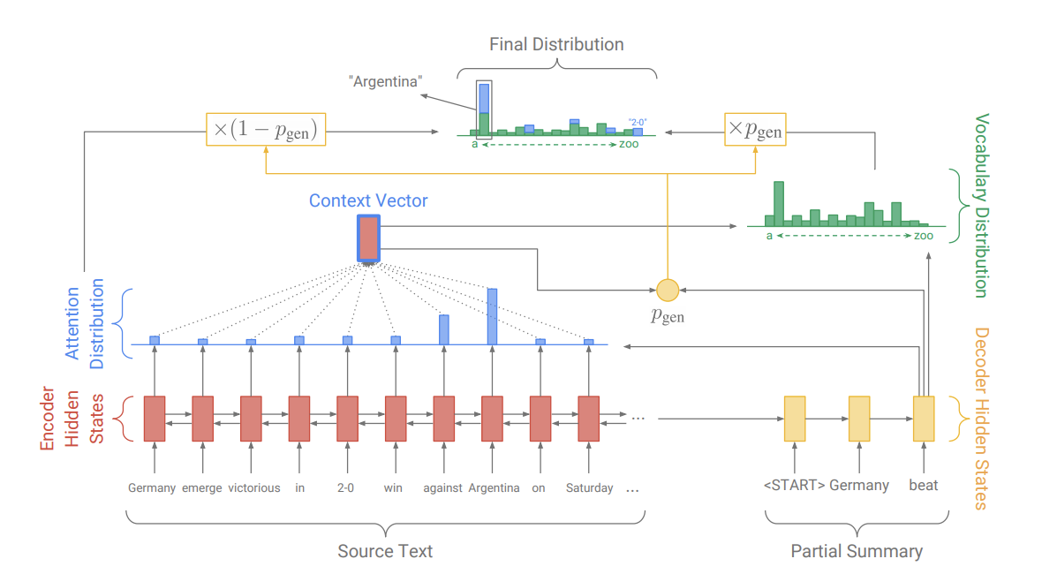
Pointer Generator

Slide 12
Other Approaches
Extractive Summarization Using Reinforcement Learning
Abstractive Summarization Using GANs
Extractive and Abstractive Summarization Using Pre-Trained Embeddings (BERT)

Slide 13
ES with Reinforcement Learning
NES PreTraining
First we build a Neural Extractive model, which given a document of n sentences produces a binary {0,1} vector for each sentence denoting whether or not it should be used in the summary.
This is done by:
Using CNN’s of varying size kernels to extract features from each word, and then concatenating them. The sentence is then represented by the mean of those concatenated vectors.
This sentence encoding is then passed through a Bi-GRU to generate a forward and backward hidden state representation which is averaged and passed through a tanh function for final doc rep.
Finally, the probability of extracting a sentence t is represented by MLP(h, Gt-1, d) where h is the concatenated hidden state rep, Gt-1 is all sentences extracted before time t and d is the doc rep.
This is pretrained in a supervised fashion, by minimizing the log likelihood of the ground truth labels.

Slide 14
Cont’d
Reinforcement
The RNES model is considered as an agent that extracts sentences sequentially from the document. At time step t, it is in state St which includes the document and prev selections.
The action is deciding {0,1} whether or not a sentence is selected, for which it receives an intermediate reward Rt, which we define as the Coherence score.
Coherence Score is calculated by concatenating embedding of prior sentence added and current sentence and passing through multiple Convolutional and Pooling Layers, and a final FC layer.
The final reward is the ROGUE metric discussed earlier

Slide 15
AS with GAN
Generator
Generator is pre-trained in similar fashion to pointer generator discussed prior
Discriminator
Trained with generator output as negative examples and human produced summaries as positive, and is trained as a binary classifier, using CNN with many filter sizes and pooling.
The generator parameters are updated using the output of the discriminator as a reward.
The generator and discriminator are then optimized like a two player game. Discriminator is updated to distinguish generator output from ground truth, and generator updated to trick the discriminator.

Slide 16
ES With bert
Leverage the fine-tuning of the already pretrained BERT model to achieve SOTA summarization results
Framed as a classification problem, Binary output for whether or not each sentence should be included in the summary or not
Done using modified BERT (see appendix)
2 transformer layers stacked on top of CLS vector output for each sentence.
Final output is a classification layer passed through sigmoid.

Slide 17
AS with bert
Similar structure to the ES model.
Instead a 6 transformer stack is added on top of the BERTSum (modified BERT).
Transformers used to make next token prediction (rather than extract features with ES).
Encoder is fine-tuned on both the ES task then the AS task.

Slide 18
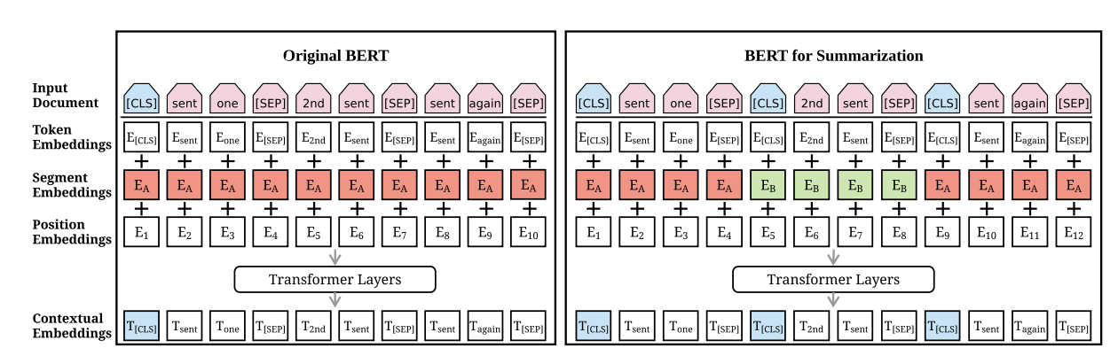
Bert Modification

Slide 19
Discussion
Thoughts on Abstractive vs Extractive summarization
Problems with summarization ?
Poorly defined task (Underconstrained-What makes a good summary)
Poorly evaluated (ROGUE-n)
Factual Inconsistency
Layout Bias in Dataset

Slide 20
Factual Inconsistency
Brady Olson, a teacher at North Thurston High, took down a gunman on Monday. A Washington High School teacher is being hailed a hero for tackling a 16-yearold student to the ground after he opened fire on Monday…
Brady Olson, a Washington High School teacher at North Thurston High, opened fire on Monday morning. No one was injured after the boy shot twice toward the ceiling in…

Slide 21
Metrics
Relevance - selection of important content from the source
Consistency - factual alignment between the summary and the source
Fluency – Quality of individual sentences
Coherence – collective quality of all sentences
Pearson Corelation – 0.07 0.08 0.08 0.06

Slide 22
Sources
Pointer – Generater: https://www.aclweb.org/anthology/P17-1099.pdf
RL: https://www.aaai.org/ocs/index.php/AAAI/AAAI18/paper/view/16838/16118
GAN: https://aaai.org/ocs/index.php/AAAI/AAAI18/paper/view/16238/16492
BERT-ES: https://www.aclweb.org/anthology/D19-1387.pdf
BERT-AS: https://arxiv.org/pdf/1909.08752.pdf
Critique: https://www.aclweb.org/anthology/D19-1051.pdf

